Slide 1
Computer Organization
Instruction Set Architecture
B.Tech. II (CSE)

Slide 2
Instruction Set Architecture
C code
A=b+c;
D=e+f;
Assembly Code
Add $s3, $s2, $s1
Add $s7, $s5, $s6
Compiler
Encoding straight forward
Machine Code
…0…1..
…0…1..

Slide 3
Instruction Set Architecture
C code
A=b+c;
D=e+f;
Assembly Code
Add $s3, $s2, $s1
Add $s7, $s5, $s6
Compiler
Machine Independent
Machine Dependent
Encoding straight forward
Defines Machine
Machine Code
…0…1..
…0…1..

Slide 4
Instruction Set Architecture
C code
A=b+c;
D=e+f;
ARM
MIPS
X86

Slide 5
Instruction Set Architecture
C code
A=b+c;
D=e+f;
ARM
Instruction Set
MIPS Instruction Set
X86
Instruction Set
MIPS
Assembly code
ARM Assembly Code
X86 Assembly Code

Slide 6
Instruction Set Architecture
Assembly Code
Add $s3, $s2, $s1
Add $s7, $s5, $s6
Instruction set is the interface between hardware and software
Instruction Set Design
•Central part of any system design
•Allows abstraction, independence

Slide 7
Why?
Early days, new computer having its own new set of instructions
Needed to allow backward compatibility

Slide 8
Topics
Instruction Set Architecture
Key of ISA using MIPS
Design Principles
Instructions
Instruction formats
Addressing modes
Notes:
Friday, November 16, 2007
Computer Architecture I - Class 11
‹#›

Slide 9
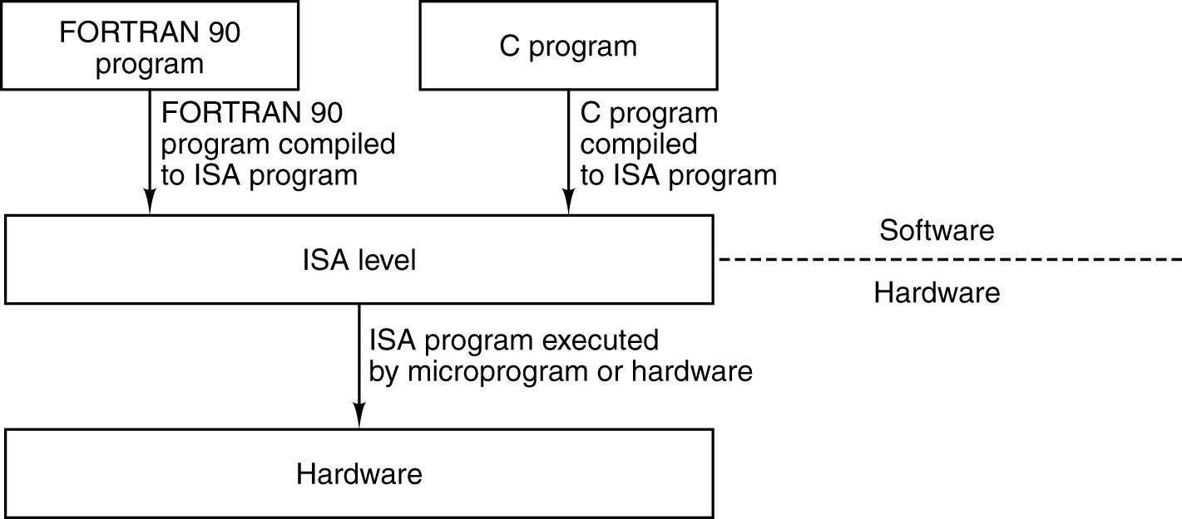
ISA
Notes:
Friday, November 16, 2007
Computer Architecture I - Class 11
‹#›

Slide 10
ISA or Instruction Set
The level - between the high-level languages and the hardware
When new hardware architecture comes along …
Can add new features to exploit new hardware capabilities
Need to maintain backward compatibility
Notes:
Friday, November 16, 2007
Computer Architecture I - Class 11
‹#›
In early days, when new machine is there, new instruction set is appearing with that.

Slide 11
ISA
ISA-level code is what a compiler outputs
Notes:
Friday, November 16, 2007
Computer Architecture I - Class 11
‹#›

Slide 12
ISA
ISA-level code is what a compiler outputs
Compiler writer needs to know
Memory model
Types of registers are available
What instructions are available
Instruction formats
Opcodes
Exceptional conditions

Slide 13
ISA
An ISA includes a specification of the set of opcodes (machine language), the native commands implemented by a particular processor
Related to programming includes
Native data types, instructions, registers, addressing modes, memory architecture, interrupt and exception handling, and external I/O

Slide 14
ISA
Distinguished from the microarchitecture
MAL which is the set of processor design techniques used to implement the instruction set
Computers with different microarchitectures can share a common instruction set
For example:
The IntelThe Intel PentiumThe Intel Pentium and the AMDThe Intel Pentium and the AMD AthlonThe Intel Pentium and the AMD Athlon implement nearly identical versions of the x86 instruction set, but have radically different internal designs

Slide 15
ISA
Stored Program Concept
Fetch & Execute Cycle
Instructions are fetched and put into a special register
Bits in the register control the subsequent actions (= execution)
Fetch the next instruction and repeat
Instructions
Encoded in binary, called machine code

Slide 16
ISA Instructions
More primitive than higher level languages,
e.g., no sophisticated control flow such as while or for loops
Different computers have different instruction sets
But with many aspects in common
Computers have very simple instruction sets
Makes the Implementation Simple

Slide 17
Instruction Set
The complete collection of instructions that are understood by a CPU
Can be considered as a functional spec for a CPU
Implementing the CPU in large part is implementing the machine instruction set
Machine Code is rarely used by humans
Binary numbers / bits
Usually represented by human readable assembly codes
In general, one assembler instruction equals one machine instruction

Slide 18
Elements of an Instruction
Operation code (Op code)
Do this
Source Operand reference
To this
Result Operand reference
Put the result here
Next Instruction Reference
When you have done that, do this...
Next instruction reference often implicit (sequential execution)

Slide 19
Operands
Main memory (or virtual memory or cache)
Requires address
CPU register
I/O device
Several forms:
Specify I/O module and device
Specify address in I/O space
Memory-mapped I/O just another memory address

Slide 20
Sample Instruction Format
N bits
X bits
Y bits
Z bits

Slide 21
Key of ISA
Operations
What operations are provided??
Operands
How many? how big?
How are memory addresses computed?
How many registers?
Where do operands reside?
e.g., can you add contents of memory to a register?
Instruction length
Are all instructions of the same length?
Instruction format
Which bits designate for what purpose??

Slide 22
Operations OR Instruction Types
Data processing
Arithmetic and logical instructions
Data storage (main memory)
Data movement (I/O)
Program flow control
Conditional and unconditional branches
Call and Return

Slide 23
ISA Architecture Types
Classification according to,
Type of INTERNAL STORAGE in CPU
Type and no. of OPERANDS

Slide 24
ISA Architecture Types
In the CPU, type of INTERNAL STORAGE is the most basic differentiation in ISA
Stack, Accumulator or Set of registers
Accordingly architectures are named:
Stack architecture
Accumulator architecture
Register architecture

Slide 25
ISA Architecture Types
Operands may be named explicitly or implicitly
Stack architecture
Implicitly on the top of the stack
Accumulator architecture
One operand is implicitly the accumulator
General-purpose register architectures
Only explicit operands—either registers or memory locations
Operands may be accessed directly from memory or may need to be first loaded into temporary storage, depending on the class of instruction and choice of specific instruction

Slide 26
ISA
Classification of Register Architecture according to the type of operands
Load-store or register-register machines
With no memory reference per ALU instruction
Register-memory
Instructions with one memory operands per typical ALU instruction
Memory-memory
Instructions with one or more than one memory operand

Slide 27
ISA ISA Architecture Types
Code C=A+B,
On these three classes of instruction sets where A, B and C all belong in Memory
1. Stack | 2. Accumulator | 3. Register
 |  | Register-Memory | Load-Store

Slide 28
ISA ISA Architecture Types
Code C=A+B,
On these three classes of instruction sets where A, B and C all belong in Memory
1. Stack | 2. Accumulator | 3. Register
 |  | Register-Memory | Load-Store
Push A Push B Add Pop C

Slide 29
ISA ISA Architecture Types
Code C=A+B,
On these three classes of instruction sets where A, B and C all belong in Memory
1. Stack | 2. Accumulator | 3. Register
 |  | Register-Memory | Load-Store
Push A Push B Add Pop C | Load A Add B Store C

Slide 30
ISA
Classes of register architecture
3.1 Register-memory architecture
Can access memory as part of any instruction
3.2 Load-store or register-register architecture
3.3 Memory-memory architecture
1. Stack | 2. Accumulator | 3. Register
 |  | Register-Memory | Load-Store
Push A Push B Add Pop C | Load A Add B Store C | Load R1, A Add R1, B Store C, R1

Slide 31
ISA
Classes of register architecture
3.1 Register-memory architecture
Can access memory as part of any instruction
3.2 Load-store or register-register architecture
Can access memory only with load and store instructions
3.3 Memory-memory architecture
1. Stack | 2. Accumulator | 3. Register
 |  | Register-Memory | Load-Store
Push A Push B Add Pop C | Load A Add B Store C | Load R1, A Add R1, B Store C, R1 | Load R1, A Load R2, B Add R3, R1, R2 Store C, R3

Slide 32
ISA
Third class of register architecture
3.3 Memory-Memory architecture
Keeps all operands in memory
Not found in today’s machines
1. Stack | 2. Accumulator | 3. Register
 |  | Register-Memory | Load-Store
Push A Push B Add Pop C | Load A Add B Store C | Load R1, A Add R1, B Store C, R1 | Load R1, A Load R2, B Add R3, R1, R2 Store C, R3

Slide 33
ISA
General Two classes of Register Architecture
3.1 Register-memory architecture
Can access memory as part of any instruction
3.2 Load-store or register-register architecture
Can access memory only with load and store instructions
Utilized in today’s machine
1. Stack | 2. Accumulator | 3. Register
 |  | Register-Memory | Load-Store
Push A Push B Add Pop C | Load A Add B Store C | Load R1, A Add R1, B Store C, R1 | Load R1, A Load R2, B Add R3, R1, R2 Store C, R3

Slide 34
ISA
Example Code (A*B)–(C*D)–(E*F)
On a stack architecture
Must be evaluated left to right, unless special operations or swaps of stack positions are done
A stack cannot be accessed randomly
On an accumulator architecture
Creating lots of bus traffic
On a register architecture
May be evaluated by multiplying in any order, which may be more efficient because of the location of the operands or because of pipelining

Slide 35
ISA
Most Early Machines used
Stack or Accumulator-style architectures
Dedicating components / registers for special uses
Less number of general-purpose registers
Trying to allocate variables to registers will not be profitable

Slide 36
ISA-Load-Store Reg. Architecture
Machines designed after 1980 uses a load-store register arch., the registers are used for variables
To reduce memory traffic
To speed up the program
As registers are faster than memory
To improve the code density
Fewer bits are needed to represent the register than the memory location
Registers are easier for a compiler to use and can be used more effectively than other forms of internal storage

Slide 37
ISA-Load-Store Reg. Architecture
How many registers are sufficient?
Answer depends on how they are used by the compiler
Most compilers reserve
Some registers for expression evaluation
Some for parameter passing
Remainder to be allocated to hold variables

Slide 38
ISA
GPR’s major concern-the no. of operands for a typical arithmetic or logical instruction
Whether ALU instruction has two or three operands
3-operand instruction format
Instruction contains a result and two source operands
2-operand instruction format
One of the operands is both a source and a result for the operation
How many of the operands may be memory addresses in ALU instructions
May vary from none to three

Slide 39
ISA
Summary of Classification of Architectures according to the type of operands

Slide 40
ISA – GPR Architecture
1) Register-register (0-Memory + 3-Reg = Total 3)
Advantage
Simple, fixed-length instruction encoding
Simple code-generation model
Instructions take similar numbers of clocks to execute
Disadvantage
Higher instruction count than architectures having memory references in instructions
Some instructions are short and bit encoding may be wasteful
Example - SPARC, MIPS, PowerPC, ALPHA

Slide 41
ISA – GPR Architecture
2) Register – memory (1- Memory + 1-Reg= Total 2)
Advantage
Data can be accessed without loading first
Instruction format tends to be easy to encode and yields good density
Disadvantage
Operands are not equivalent since a source operand in a binary operation is destroyed
Encoding a register number and a memory address in each instruction may restrict the number of registers
Clocks per instruction varies by operand location
Example - Intel 80x86, Motorola 68000

Slide 42
ISA – GPR Architecture
3) Memory-memory (3-Memory + 0-Reg = Total-3)
Advantage
Most compact
Doesn’t waste registers for temporaries
Disadvantage
Large variation in instruction size, especially for three-operand instructions
Also, large variation in work per instruction
Memory accesses create memory bottleneck
Example - VAX

Slide 43
ISA
Summary, In general,
Machines with fewer alternatives make the compiler’s task simpler since there are fewer decisions for the compiler to make
Machines with a wide variety of flexible instruction formats reduce the number of bits required to encode the program
A machine that uses a small number of bits to encode the program is said to have good instruction density—a smaller number of bits do as much work as a larger number on a different architecture
The no. of registers also affects the instruction size

Slide 44
Operands
How many operands are supported?
3 operands
2 operands
1 operand
0 operand

Slide 45
No. of Operands
3 operands
Operand 1, Operand 2, Result
a = b + c;
add ax, bx, cx
May be a fourth address - next instruction (usually implicit)[not common]
Instructions are long because 3 or more operands have to be specified

Slide 46
No. of Operands
2 Operands
One address doubles as operand and result
a = a + b
add ax, bx
Reduces length of instruction over 3-address format
Requires some extra work by processor
Temporary storage to hold some results

Slide 47
No. of Operands
1 Operand
Implicit second address
Usually a register (accumulator)
Common on early machines
Used in some Intel x86 instructions with implied operands
mul ax
idiv ebx

Slide 48
No. of Operands
0 (zero) Operand
All addresses implicit
Uses a stack- X87 example c = a + b:
push a
push b
fadd //a+b, pop stack
store and pop c
Can reduce to 3 instructions:
push a
push b
faddp c ; //add and pop

Slide 49
Computation of Y = (a-b) / (c + (d * e))
Three Operands instructions
Two Operandsinstructions
One Operand instructions

Slide 50
Computation of Y = (a-b) / (c + (d * e))
Three Operands instructions
sub y,a,b
mul t,d,e
add t,t,c
div y,y,t
Two Operands instructions
mov y,a
sub y,b
mov t,d
mul t,e
add t,c
div y,t

Slide 51
Computation of Y = (a-b) / (c + (d * e))
One Operand instructions
load d
mul e
add c
store y
load a
sub b
div y
store y

Slide 52
How Many Operands?
More Operands
More complex instructions
More registers
Inter-register operations are quicker
Fewer instructions per program
More complexity in processor
Fewer Operands
Less complex instructions
One address format however limits you to one register
More instructions per program
Less complexity in processor
Faster fetch/execution of instructions

Slide 53
Memory Organization
Viewed as a large single-dimension array with access by address
A memory address is an index into the memory array
Two views of Memory
Byte Addressing
The index points to a byte of memory, and that the unit of memory accessed by a load/store is a byte
Word Addressing
0
8 bits of data
1
8 bits of data
2
8 bits of data
3
8 bits of data
4
8 bits of data
5
8 bits of data
6
8 bits of data
...
Notes:
Friday, November 16, 2007
Computer Architecture I - Class 11
‹#›

Slide 54
Memory Organization
How many bytes (8 bits) and words (32 bits) can be accessed for 4 GB Memory?
2³² bytes with byte addresses from 0 to 2³²-1
2³⁰ words with byte addresses 0, 4, 8, ... 2³²-4
Words are aligned
Notes:
Friday, November 16, 2007
Computer Architecture I - Class 11
‹#›

Slide 55
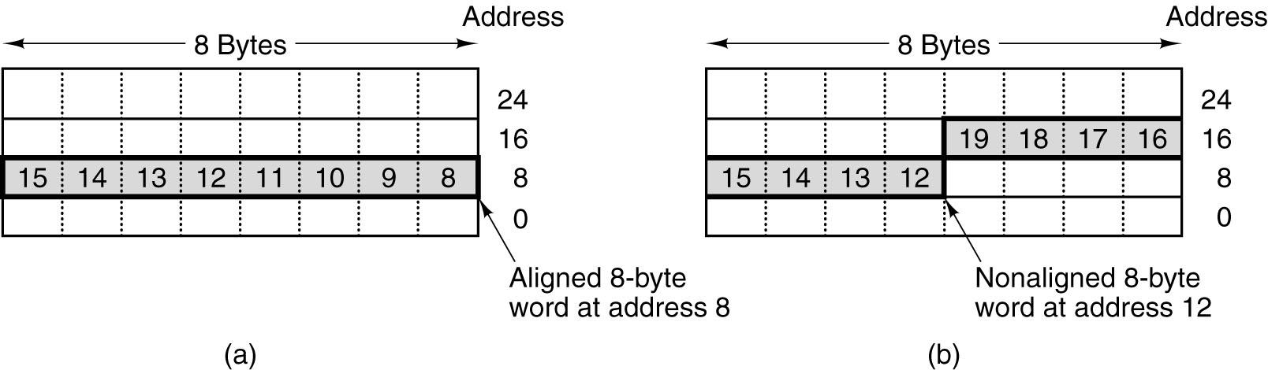
Memory Organization
Why Word alignment ?
Memories operate more efficiently this way
Consider 8-byte (64-bit) words
Notes:
Friday, November 16, 2007
Computer Architecture I - Class 11
‹#›
Word alignment is often required because memories operate more efficiently that way. The Pentium 4, for example, requires it (in fact, it forces it, since it fetches 8 bytes at a time, uses 36-bit physical addresses, but only has 33 address bits; the low order 3 bits are not specified and are forced to 0, making all memory addresses be multiples of 8 bytes).

Slide 56
Memory Organization
Bytes in a word can be numbered in two ways:
Big Endian
Most-significant byte at least address of a word
MIPS is Big Endian
Little Endian
Least-significant byte at least address
? Is Little Endian

Slide 57
Memory Organization
Example: Store the number 12 in 32 bits
There will be 28 zeroes and then 1100
(MSB) 00000000 00000000 00000000 00001100 (LSB)
Big-endian
Little-endian
Byte 0:
1:
2:
3:
0000 0000
0000 0000
0000 0000
0000 1100
0000 1100
0000 0000
0000 0000
0000 0000
The big-endian system 1100 is in byte 3
The little-endian system 1100 is in byte 0

Slide 58
ISA
Example ISA’s:
Digital’s VAX (1977)
Intel’s x86 (1978), but successful (IBM PC)
MIPS – focus of text, used in assorted machines
PowerPC – used in Mac’s, IBM supercomputers, ...
VAX and x86 are CISC (“Complex Instruction Set Computers”)
Started in 70’s
MIPS and PowerPC are RISC (“Reduced Instruction Set Computers”)
Almost all machines of 80’s and 90’s are RISC
Including VAX’s successor, the DEC Alpha

Slide 59
RISC vs. CISC
RISC
• Instructions in Instruction set of processor are simple and few in number
• Instructions to access memory
- only LOAD/STORE
• Instruction length - Fixed
• Addressing modes - Few
• Complexity in compiler
• Achieves shorten execution time by reducing the clock cycles per instruction (i.e. simple instructions take less time to interpret)
CISC
• Many complex instructions
• Instructions to access memory - many instructions can access
• Instruction length - Variable
• Addressing modes - Many
• Complexity in microcode
• Achieves shorten execution time by reducing the number of instructions per program
And many more as discussed in class…

Slide 60
Example for RISC vs. CISC
Multiplication:
Mov ax,10
Mov bx,5
Mul bx, ax
Mov ax,0
Mov bx,10
Mov cx, 5
Begin: Add ax,bx
Loop begin
CISC:
RISC:
The total clock cycles for the CISC version might be:
(2 movs × 1 cycle) + (1 mul × 30 cycles)
= 32 cycles
While the clock cycles for RISC version is:
(3 movs × 1 cycle) + (5 adds × 1 cycle) + (5 loops × 1 cycle)
= 13 cycles

Slide 61
ISA
Design goals:
Maximize performance
Minimize cost
Reduce design time

Slide 62
The MIPS
Microprocessor without Interlocked Pipeline Stages
RISC instruction set architecture (ISA)
Large share of embedded core market
Applications in consumer electronics, network / storage equipment, cameras, printers, …
Typical of many modern ISAs

Slide 63
MIPS Instruction Set
What should be considered?
Operations (MIPS Arithmetic)
MIPS Operand
Register
Memory

Slide 64
Operations (MIPS Arithmetic)
Example:
C code: A = B + C
C code: A = B + C + D + E
C code: F = (G + H) – (I + J)
C code: G = H + A[8];

Slide 65
Operations (MIPS Arithmetic)
Example:
C code: A = B + C
All MIPS arithmetic instructions have 3 operands
Operand order is fixed (e.g., destination first)
MIPS code: Add A, B, C

Slide 66
MIPS Arithmetic
Example:
C code: A = B + C + D + E
MIPS code:
Add A, B, C
Add A, A, D
Add A, A, E

Slide 67
MIPS Arithmetic
Example:
C code: F = (G + H) – (I + J)
MIPS code:
Add F, G, H
Sub F, I, J
Notes:
Not all the time correct, find the correction…
Friday, November 16, 2007
Computer Architecture I - Class 11
‹#›

Slide 68
MIPS Arithmetic
Example:
C code: F = (G + H) – (I + J)
MIPS code: //Use of temporary variables
Add $t0, G, H
Add $t1, I, J
Sub F, $t0, $t1

Slide 69
MIPS Arithmetic
Design Principle 1:
Simplicity favors regularity.
i.e. Regularity makes implementation simpler
Simplicity enables higher performance at lower cost

Slide 70
MIPS Operand
Arithmetic instructions use register operands
MIPS has a 32 × 32-bit register file
Use for frequently accessed data
32-bit data called a “word”

Slide 71
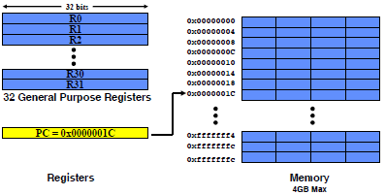
MIPS Registers and Memory

Slide 72
MIPS Operand
Arithmetic instructions use register operands
MIPS has a 32 × 32-bit register file
Use for frequently accessed data
32-bit data called a “word”
Assembler names
$t0, $t1, …, $t9 for temporary values
$s0, $s1, …, $s7 for saved variables // C variables

Slide 73
MIPS Operand
Only 32 Registers?
Design Principle 2:
Smaller is faster.
Why?
Electronic signals have to travel further on a physically larger chip increasing clock cycle time
Smaller is also cheaper!

Slide 74
MIPS Register Operand
C code:
f = (g + h) - (i + j);
Compiled MIPS code:
f, …, j in $s0, …, $s4
Add $t0, $s1, $s2
Add $t1, $s3, $s4
Sub $s0, $t0, $t1

Slide 75
MIPS Register Operand
Arithmetic instructions operands must be in registers
MIPS has only 32 registers
Compiler associates variables with registers
What about programs with lots of variables (arrays, etc.)?

Slide 76
MIPS Memory Operands
Main memory used for composite data
Arrays, structures, dynamic data
To apply arithmetic operations
Load values from memory into registers
Store result from register to memory

Slide 77
MIPS Registers and Memory

Slide 78
MIPS Memory Organization
Memory is byte addressed
Each address identifies an 8-bit byte
A word is 32 bits or 4 bytes
Address must be a multiple of 4
Words are aligned in memory
Follows Big-Endian Ordering

Slide 79
MIPS Load/Store Instructions
Instruction
Add $s1, $s2, $s3
Sub $s1, $s2, $s3
Lw $s1, 100($s2)
Sw $s1, 100($s2)
Meaning
$s1 = $s2 + $s3
$s1 = $s2 – $s3
$s1 = Memory[$s2+100]
Memory[$s2+100]= $s1

Slide 80
Instruction Format: R Type

Slide 81
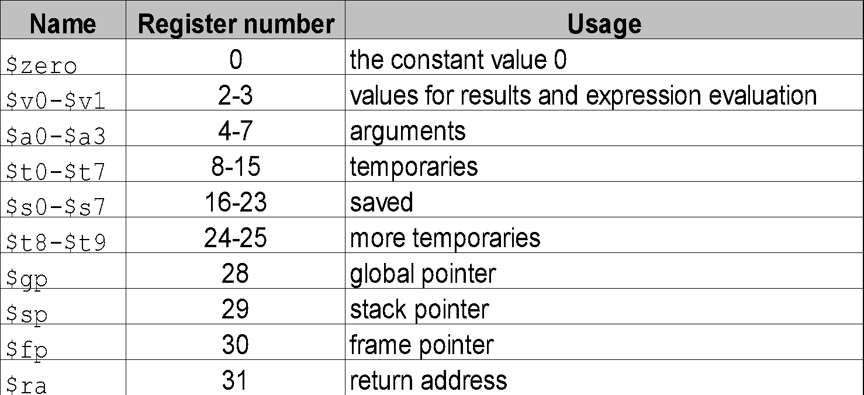
MIPS Operand - Register
Register 1, called $at, is reserved for the assembler; registers 26-27,
called $k0 and $k1 are reserved for the operating system
Require 5 bits to select one register
Notes:
Friday, November 16, 2007
Computer Architecture I - Class 11
‹#›

Slide 82
Instruction Format: R Type
Opcode and Operand
3 Registers Operands
15 bits for Register Operands
Opcode

Slide 83
Instruction Format: R Type
op rs rt rd shamt funct
opcode –
operation
first
register
source
operand
second
register
source
operand
register
destin-
ation
operand
shift
amount
00000 for
now
function field -
selects variant
of operation
extends opcode
6 bits 5 bits 5 bits 5 bits 5 bits 6 bits

Slide 84
R Type Format Example
op rs rt rd shamt funct
opcode –
operation
first
register
source
operand
second
register
source
operand
register
destin-
ation
operand
shift
amount
00000 for
now
function field -
selects variant
of operation
extends opcode
6 bits 5 bits 5 bits 5 bits 5 bits 6 bits
$t0 – $t7: Registers are: 8 – 15
$t8 – $t9: Registers are: 24 – 25
$s0 – $s7:Registers are: 16 – 23
Add $t0, $s1, $s2
special $s1 $s2 $t0 0 add
0 17 18 8 0 32
000000 10001 10010 01000 00000 100000
00000010 00110010 01000000 00100000₂ = 02 32 40 20₁₆

Slide 85
R Type Format Example
$t0 – $t7: Registers are: 8 – 15
$t8 – $t9: Registers are: 24 – 25
$s0 – $s7:Registers are: 16 – 23
Sub $t0, $s1, $s2
special $s1 $s2 $t0 0 sub
0 17 18 8 0 34
000000 10001 10010 01000 00000 100010
00000010 00110010 01000000 00100000₂ = 02 32 40 22₁₆

Slide 86
MIPS Instructions
Design Principle 3:
Good design demands good compromises
Different formats complicate decoding
Keep formats as similar as possible

Slide 87
Immediate Operands
Small constants are used quite frequently (50% of operands)
Make operand part of instruction itself!
Introduce a new type of instruction format with Immediate operands
Design Principle 4: Make the common case fast
Example:
addi $sp, $sp, 4 # $sp = $sp + 4, $sp=29
addi $t0, $t0, -5 # $t0 = $t0 - 5

Slide 88
Immediate Operands
For example:
Constant data specified in an instruction
Addi $s3, $s3, 4 # $s3 = $s3 + 4
Addi $sp, $sp, 4 # $sp = $sp + 4
No subtract immediate instruction
Just use a negative constant
Addi $s2, $s1, -1

Slide 89
Instruction Format: I Type
op rs rt constant or address
6 bits 5 bits 5 bits 16 bits
opcode –
operation
first
register
source
operand
second
register
source
operand
constant: –2¹⁵ to +2¹⁵ – 1
address: offset added to
base address in rs

Slide 90
Immediate Operands
Example: addi $sp, $sp, 4 # $sp = $sp + 4, $sp=29
op
rs
rt
16 bit number
6 bits 5 bits 5 bits 16 bits
001000
11101
11101
0000000000000100
6 bits 5 bits 5 bits 16 bits

Slide 91
Instruction Format
Load Instruction
Lw $s1, 100($s2)
Two Registers
A Constant
If consider, the third register to store this
Would be limited to 5 bits only i.e. upto 32
This may be larger than 32
So, 5-bit field is too small
?

Slide 92
MIPS Load/Store Instructions
Load word has destination first
Store has destination last
MIPS arithmetic operands are registers, not memory locations
Therefore, words must first be moved from memory to registers using loads before they can be operated on; then result can be stored back to memory
Notes:
Friday, November 16, 2007
Computer Architecture I - Class 11
‹#›

Slide 93
MIPS Load/Store Instructions
C code:
G = H + A[8];
G in $s1, H in $s2, base address of A in $s3
Compiled MIPS code:
Index 8 requires offset of 32, due to 4 bytes/word
Lw $t0, 32($s3) # load word
Add $s1, $s2, $t0
Value
Offset
Base address

Slide 94
MIPS Load/Store Instructions
C code:
A[12] = H + A[8];
MIPS code:
?
Load : Lw $t0, 32($s3)
Arithmetic : Add $t0, $s2, $t0 Store : Sw $t0, 48($s3)
Notes:
Friday, November 16, 2007
Computer Architecture I - Class 11
‹#›

Slide 95
Instruction Format: I Type
op rs rt constant or address
6 bits 5 bits 5 bits 16 bits
opcode –
operation
first
register
source
operand
second
register
source
operand
constant: –2¹⁵ to +2¹⁵ – 1
address: offset added to
base address in rs
$t0 – $t7: Registers are: 8 – 15
$t8 – $t9: Registers are: 24 – 25
$s0 – $s7:Registers are: 16 – 23
lw $t0, 1002($s2)
100011 10010 01000 0000001111101010

Slide 96
Example : I Type Format
C code:
A[300] = H + A[300];
MIPS code:
Lw $t0, 1200($t1)
Add $t0, $s2, $t0
Sw $t0, 1200($t1)

Slide 97
Example: I Type Format
op rs rt rd shamt/ funct
address
35 9 8 1200
0 18 8 8 0 32
43 9 8 1200
$t0 – $t7: Registers are: 8 – 15
$t8 – $t9: Registers are: 24 – 25
$s0 – $s7:Registers are: 16 – 23
Lw $t0, 1200($t1)
Add $t0, $s2, $t0
Sw $t0, 1200($t1)

Slide 98
Logical Operations
Instructions for bitwise manipulation
Operation | C | MIPS
Shift Left Shift Right Bitwise AND Bitwise OR Bitwise NOT | << >> & | ~ | sll srl and, andi or, ori nor
Useful for extracting and inserting groups
of bits in a word

Slide 99
Shift Operations
op rs rt rd shamt funct
6 bits 5 bits 5 bits 5 bits 5 bits 6 bits
shamt: how many positions to shift
Shift left logical
Shift left and fill with 0 bits
Sll by i bits multiplies by 2^{i}
Shift right logical
Shift right and fill with 0 bits
Srl by i bits divides by 2^{i} (unsigned only)

Slide 100
AND Operations
Useful to mask bits in a word
Select some bits, clear others to 0
Example:
And $t0, $t1, $t2 # $t0 = $t1 & $t2
$t2 = 0000 0000 0000 0000 0000 1101 1100 0000
$t1 = 0000 0000 0000 0000 0011 1100 0000 0000
$t0 = 0000 0000 0000 0000 0000 1100 0000 0000

Slide 101
OR Operations
Useful to include bits in a word
Select some bits to 1, leave others unchanged
Example:
Or $t0, $t1, $t2 # $t0 = $t1 | $t2
$t2 = 0000 0000 0000 0000 0000 1101 1100 0000
$t1 = 0000 0000 0000 0000 0011 1100 0000 0000
$t0 = 0000 0000 0000 0000 0011 1101 1100 0000

Slide 102
The Constant Zero
MIPS register 0 ($zero) is the constant 0
Cannot be overwritten
Useful for common operations
E.g., move between registers:
Value of $s1 to $t2
Add $t2, $s1, $zero

Slide 103
NOT Operations
Useful to invert bits in a word
Change 0 to 1, and 1 to 0
MIPS has NOR 3-operand instruction
a NOR b == NOT ( a OR b )
Example:
Nor $t0, $t1, $zero # Register 0: always read as zero
$t1 = 0000 0000 0000 0000 0011 1100 0000 0000
$t0 = 1111 1111 1111 1111 1100 0011 1111 1111

Slide 104
Conditional Operations
Decision making instructions
alter the control flow,
i.e., change the next instruction to be executed
Notes:
Friday, November 16, 2007
Computer Architecture I - Class 11
‹#›

Slide 105
MIPS conditional instructions
Branch to a labeled instruction if a condition is true
Otherwise, continue sequentially
Beq rs, rt, L1
if (rs == rt) branch to instruction labeled L1;
Bne rs, rt, L1
if (rs != rt) branch to instruction labeled L1;
J L1
unconditional jump to instruction labeled L1

Slide 106
Compiling If Statements
C code:
if (i==j) f = g+h;
else f = g-h;
f, g, … in $s0, $s1, …
Compiled MIPS code:
Bne $s3, $s4, Else
Add $s0, $s1, $s2
J Exit
Else: Sub $s0, $s1, $s2
Exit: …
Assembler calculates addresses

Slide 107
Compiling Loop Statements
C code: (with Variable Array Index)
Loop: g = g + A[i];
i = i + j;
if ( i != h) goto Loop;
Variables g, h, i and j to the registers $s1, $s2, $s3 and $s4
Assume A is an array of 100 elements and its base address is in $s5

Slide 108
C code to MIPS code
C Code:
g = g + A[i];
Assume A is an array of 100 elements and its base address is in $s3
Variables g and i to the registers $s1 and $s4

Slide 109
C (g = g + A[i];) to MIPS
Array A of 100 elements and its base address is in $s3
Variables G and i to the registers $s1 and $s4
Load A[i] into a temporary register
Due to Byte Addressing, Must multiply i by 4
i.e. i + i = 2i and then 2i + 2i = 4i
MIPS Code:
add $t1, $s4, $s4 # $t1 = 2 * i
add $t1, $t1, $t1 # $t1 = 4 * i

Slide 110
C (g = g + A[i];) to MIPS
Array A of 100 elements and its base address is in $s3
Variables G and i to the registers $s1 and $s4
To get the address of A[i],
Need to add $t1 and the base of A in $s3
i.e., add $t1, $t1, $s3
# $t1=address of A[i] (4 * i + $s3)

Slide 111
C (g = g + A[i];) to MIPS
Now use Load A[i] into a temporary register
i.e., lw $t0, 0($t1)
# $t0 = A[i]
Final Instruction adds A[i] and g, and places the sum in g:
i.e., add $s1, $s1, $t0
# g = g + A[i]

Slide 112
C (g = g + A[i];) to MIPS
MIPS Code:
add $t1, $s4, $s4 # $t1 = 2 * i
add $t1, $t1, $t1 # $t1 = 4 * I
add $t1, $t1, $s3 # $t1=address of A[i] (4 * i + $s3)
lw $t0, 0($t1) # $t0 = A[i]
add $s1, $s1, $t0 # g = g + A[i]

Slide 113
Compiling Loop Statements
C code: (with Variable Array Index)
Loop: g = g + A[i]; i = i + j; if ( i != h) goto Loop;
Variables g, h, i and j to the registers $s1, $s2, $s3 and $s4
Array A of 100 elements and its base address is in $s5
Compiled MIPS code:
Loop: add $t1, $s3, $s3 # Temp reg $t1 = 2 * i
add $t1, $t1, $t1 # Temp reg $t1 = 4 * i
add $t1, $t1, $s5 # $t1 = address of A[i]
lw $t0, 0($t1)
add $s1, $s1, $t0 # g = g +A[i]
add $s3, $s3, $s4 # i = i + j
bne $s3, $s2, Loop

Slide 114
Compiling While Loop
C code:
while (save[i] == k)
i = i + j;
i in $s3, j in $s4, k in $s5, base address of save in $s6
Compiled MIPS code: ?

Slide 115

Probable Solution 1
while: add $t1,$s3,$s3;
add $t1,$t1,$t1;
add $t1 ,$t1,$s6;
lw $t0,0($t1);
Beq $t0,$s5,here;
here:add $s3,$s3,$s4;
Exit:

Slide 116
Probable Solution 2
while: add $t1,$s3,$s3;
add $t1,$t1,$t1;
add $t1 ,$t1,$s6;
lw $t0,0($t1);
Beq $t0,$s5,here;
exit
here:add $s3,$s3,$s4;
J while

Slide 117
Probable Solution 3
add t1,s3,s3
add t1,t1,t1
add t0,s4,s4
add t0,t0,t0
add t0,t0,s4
loop: load s1,0(t1)
bnq s1,s5 exit
add t1,t1,t0
j loop
exit: .....

Slide 118
Probable Solution 4
while: add $t1,$s3,$s3 // Address
add $t1,$t1,$t1
add $t1,$t1,$s4 // $s4=Base Addr
lw $t0, 0($t1)
Beq $t0, $s5, body // Equality Check
J Exit
body: add $s3,$s3,$s4
J while
Exit : ...

Slide 119
Compiling Loop Statements
C code:
while (save[i] == k) i = i + j;
i in $s3, j in $s4, k in $s5, base address of save in $s6
Compiled MIPS code:
Loop: add $t1, $s3, $s3 # Temp reg $t1 = 2 * i
add $t1, $t1, $t1 # Temp reg $t1 = 4 * i
add $t1, $t1, $s6 # $t1 = address of save[i]
lw $t0, 0($t1) # Temp reg $t0 = save[i]
bne $t0, $s5, Exit # Go to Exit if save[i] != k
add $s3, $s3, $s4 # i = i + j
j Loop # Go to loop
Exit:

Slide 120
More Conditional Operations
Set result to 1 if a condition is true
Otherwise, set to 0
slt rd, rs, rt
if (rs < rt) rd = 1; else rd = 0;
slti rt, rs, constant
if (rs < constant) rt = 1; else rt = 0;
Use in combination with beq, bne
slt $t0, $s1, $s2 # if ($s1 < $s2)
bne $t0, $zero, L # branch to L

Slide 121
Compiling Loop Statements
C code:
while (save[i] == k) i += 1;
i in $s3, k in $s5, address of save in $s6
Compiled MIPS code:
?

Slide 122
Tutorial Question
C code:
switch (k){
case 0: f = i + j; break;
case 1: f = g + h; break;
case 2: f = g - h; break;
case 3: f = i - j; break;
}
Six variables f through k correspond to six registers $s0 through $s5
Compiled MIPS code: ?

Slide 123
Branch Instruction Format
Instructions:
beq rs, rt, L1
bne rs, rt, L1
Specify:
Opcode, two registers, target address
16 bit Address ?
op rs rt constant or address
6 bits 5 bits 5 bits 16 bits

Slide 124
Branch Addressing
16 bits is too small a reach in a 2³² address space
Solution:
Principle of locality
Most branch targets are near branch
Forward or backward Direction
Use PC (= program counter), called PC-relative addressing based on Principle of Locality
PC-relative addressing
Target address = PC + offset × 4
PC already incremented by 4 by this time

Slide 125
Target Addressing Example
C code:
while (save[i] == k)
i = i + j;
//i in $s3, j in $s4, k in $s5,
base address of save in $s6
Assume Loop at location 80000

Slide 126
Target Addressing Example
C code: while (save[i] == k) i = i + j; i in $s3, j in $s4, k in $s5, base address of save in $s6
Compiled MIPS code:
Loop: add $t1, $s3, $s3
add $t1, $t1, $t1
add $t1, $t1, $s6
lw $t0, 0($t1)
bne $t0, $s5, Exit
add $s3, $s3, $s4
j Loop
Exit:
Assume Loop at location 80000
80000 | 0 | 19 | 19 | 9 | 0 | 32
80004 | 0 | 9 | 9 | 9 | 0 | 32
80008 | 0 | 9 | 21 | 9 | 0 | 32
80012 | 35 | 9 | 8 | 0
80016 | 5 | 8 | 21 | ?
80020 | 0 | 19 | 20 | 19 | 0 | 32
80024 | 2 | ?
80028 | …
80012 | 35 | 9 | 8 | 0

Slide 127
Target Addressing Example
C code: while (save[i] == k) i = i + j; i in $s3, j in $s4, k in $s5, base address of save in $s6
Compiled MIPS code:
Loop: add $t1, $s3, $s3
add $t1, $t1, $t1
add $t1, $t1, $s6
lw $t0, 0($t1)
bne $t0, $s5, Exit
add $s3, $s3, $s4
j Loop
Exit:
Assume Loop at location 80000
80000 | 0 | 19 | 19 | 9 | 0 | 32
80004 | 0 | 9 | 9 | 9 | 0 | 32
80008 | 0 | 9 | 21 | 9 | 0 | 32
80012 | 35 | 9 | 8 | 0
80016 | 5 | 8 | 21 | 80028
80020 | 0 | 19 | 20 | 19 | 0 | 32
80024 | 2 | 80000
80028 | …
80012 | 35 | 9 | 8 | 0

Slide 128
Target Addressing Example
C code: while (save[i] == k) i = i + j; i in $s3, j in $s4, k in $s5, base address of save in $s6
Compiled MIPS code:
Loop: add $t1, $s3, $s3
add $t1, $t1, $t1
add $t1, $t1, $s6
lw $t0, 0($t1)
bne $t0, $s5, Exit
add $s3, $s3, $s4
j Loop
Exit:
Assume Loop at location 80000
80000 | 0 | 19 | 19 | 9 | 0 | 32
80004 | 0 | 9 | 9 | 9 | 0 | 32
80008 | 0 | 9 | 21 | 9 | 0 | 32
80012 | 35 | 9 | 8 | 0
80016 | 5 | 8 | 21 | 8
80020 | 0 | 19 | 20 | 19 | 0 | 32
80024 | 2 | 80000
80028 | …
80012 | 35 | 9 | 8 | 0

Slide 129
Target Addressing Example
C code: while (save[i] == k) i = i + j; i in $s3, j in $s4, k in $s5, base address of save in $s6
As the PC-Relative addressing refers the number of words to the next instruction instead of the number of bytes.
So, 8 bytes is replaced by
2 words
Compiled MIPS code:
Loop: add $t1, $s3, $s3
add $t1, $t1, $t1
add $t1, $t1, $s6
lw $t0, 0($t1)
bne $t0, $s5, Exit
add $s3, $s3, $s4
j Loop
Exit:
Assume Loop at location 80000
80000 | 0 | 19 | 19 | 9 | 0 | 32
80004 | 0 | 9 | 9 | 9 | 0 | 32
80008 | 0 | 9 | 21 | 9 | 0 | 32
80012 | 35 | 9 | 8 | 0
80016 | 5 | 8 | 21 | 2
80020 | 0 | 19 | 20 | 19 | 0 | 32
80024 | 2 | 80000
80028 | …
80012 | 35 | 9 | 8 | 0

Slide 130
Jump Addressing
Jump (j) targets could be anywhere in text segment
Encode full address in instruction
Pseudo-Direct jump addressing
26 bit address is concatenated with the upper bits of the PC
Target address = PC31…28 : (address × 4)
op address
6 bits 26 bits

Slide 131
Jump Addressing
MIPS jump j instruction replaces lower 28 bits of the PC with A00 where A is the 26 bit address; it never changes upper 4 bits
Example:
if PC = 1011X (where X = 28 bits), it is replaced with 1011A00
Why Not upper 4 bits?
Address space size = 2³²
There are 16(=2⁴) partitions of memory, each partition of size 256 MB (=2²⁸), such that, in each partition the upper 4 bits of the address is same.
If a program crosses an address partition, then a j that reaches a different partition has to be replaced by jr with a full 32-bit address first loaded into the jump register
Therefore, OS should always try to load a program inside a single partition

Slide 132
Jump Addressing
Example:
J Label # Address of Label = 100
26-bit Pseudodirect address is 100/4 = 25
op
26 bit number
6 bits 26 bits
000010
00000000000000000000011001

Slide 133
Target Addressing Example
C code: while (save[i] == k) i = i + j; i in $s3, j in $s4, k in $s5, base address of save in $s6
Compiled MIPS code:
Loop: add $t1, $s3, $s3
add $t1, $t1, $t1
add $t1, $t1, $s6
lw $t0, 0($t1)
bne $t0, $s5, Exit
add $s3, $s3, $s4
j Loop
Exit:
Assume Loop at location 80000
80000 | 0 | 19 | 19 | 9 | 0 | 32
80004 | 0 | 9 | 9 | 9 | 0 | 32
80008 | 0 | 9 | 21 | 9 | 0 | 32
80012 | 35 | 9 | 8 | 0
80016 | 5 | 8 | 21 | 2
80020 | 0 | 19 | 20 | 19 | 0 | 32
80024 | 2 | 80000
80028 | …
80012 | 35 | 9 | 8 | 0

Slide 134
Target Addressing Example
C code: while (save[i] == k) i = i + j; i in $s3, j in $s4, k in $s5, base address of save in $s6
Compiled MIPS code:
Loop: add $t1, $s3, $s3
add $t1, $t1, $t1
add $t1, $t1, $s6
lw $t0, 0($t1)
bne $t0, $s5, Exit
add $s3, $s3, $s4
j Loop
Exit:
Assume Loop at location 80000
80000 | 0 | 19 | 19 | 9 | 0 | 32
80004 | 0 | 9 | 9 | 9 | 0 | 32
80008 | 0 | 9 | 21 | 9 | 0 | 32
80012 | 35 | 9 | 8 | 0
80016 | 5 | 8 | 21 | 2
80020 | 0 | 19 | 20 | 19 | 0 | 32
80024 | 2 | 20000
80028 | …
80012 | 35 | 9 | 8 | 0
As the Pseudo-Direct jump addressing

Slide 135
More Conditional Operators
Signed vs. Unsigned
Signed comparison: slt, slti
Unsigned comparison: sltu, sltui
Example
$s0 = 1111 1111 1111 1111 1111 1111 1111 1111
$s1 = 0000 0000 0000 0000 0000 0000 0000 0001
slt $t0, $s0, $s1 # signed
–1 < +1 🡪 $t0 = 1
sltu $t0, $s0, $s1 # unsigned
+4,294,967,295 > +1 🡪 $t0 = 0

Slide 136
Immediate Operands
Small constants are used quite frequently (50% of operands)
Make operand part of instruction itself!
Design Principle 4: Make the common case fast
Example: addi $sp, $sp, 4 # $sp = $sp + 4, $sp=29
What If Constants are LARGER than 16-bits ?
001000
11101
11101
0000000000000100
6 bits 5 bits 5 bits 16 bits
op
rs
rt
16 bit number

Slide 137
How about larger constants?
First we need to load a 32 bit constant into a register
Must use two instructions for this: first new load upper immediate instruction for upper 16 bits lui $t0, 1010101010101010
Notes:
Friday, November 16, 2007
Computer Architecture I - Class 11
‹#›

Slide 138
How about larger constants?
To load $t0 with 1010… upto 32 bits
lui $t0, 1010101010101010
Then get lower 16 bits in place: ori $t0, $t0, 1010101010101010
Now the constant is in place, use register-register arithmetic
filled with zeros
1010101010101010
0000000000000000
1010101010101010
0000000000000000
0000000000000000
1010101010101010
ori
1010101010101010
1010101010101010
Notes:
Friday, November 16, 2007
Computer Architecture I - Class 11
‹#›

Slide 139
Larger Constants
Example:
Load the register $s0 with the value:
400000010 = 3D090016
= 0000 0000 0011 1101 0000 1001 0000 00002
MIPS Code:
lui $s0 6110 # 6110 = 0000 0000 0011 11012
addi $s0, $s0, 230410 # 230410 = 0000 1001 0000 00002

Slide 140
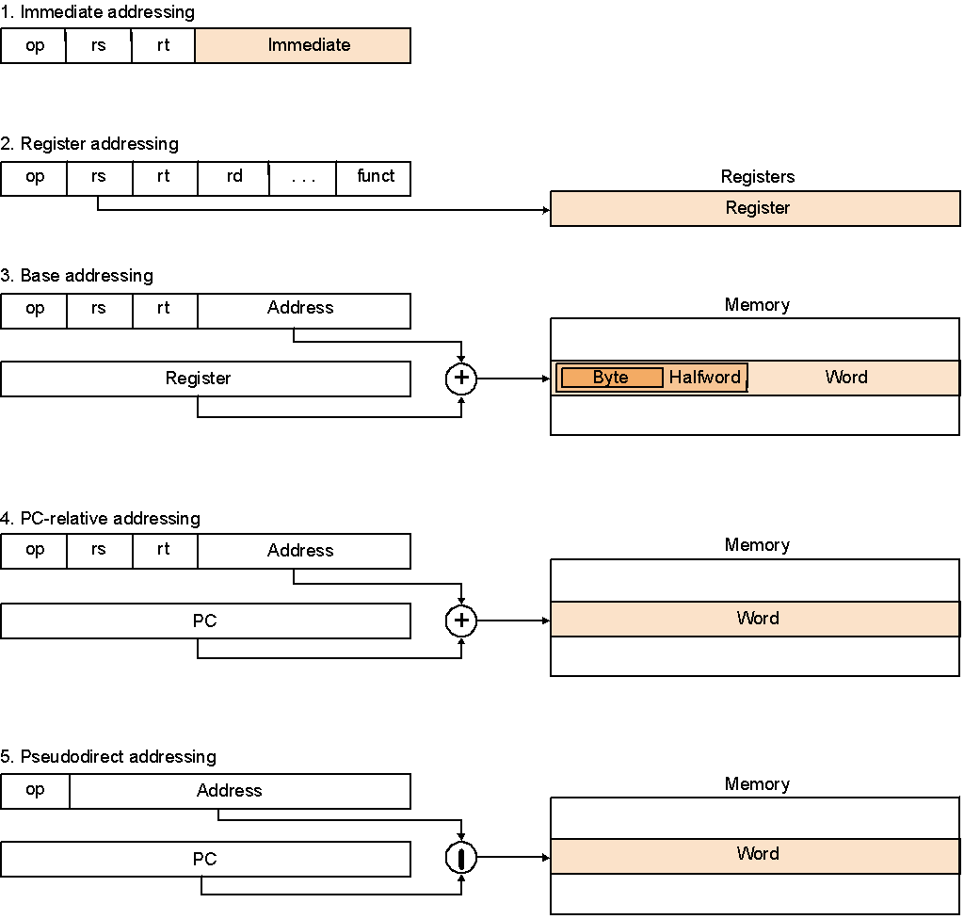
MIPS Addressing Modes

Slide 141
So far
Instruction Format Meaning add $s1,$s2,$s3 R $s1 = $s2 + $s3 sub $s1,$s2,$s3 R $s1 = $s2 – $s3 lw $s1,100($s2) I $s1 = Memory[$s2+100] sw $s1,100($s2) I Memory[$s2+100] = $s1 bne $s4,$s5,Lab1 I Next instr. is at Lab1 if $s4 != $s5 beq $s4,$s5,Lab2 I Next instr. is at Lab2 if $s4 = $s5 j Lab3 J Next instr. is at Lab3
Formats:
Simple instructions – all 32 bits wide, Very structured – no unnecessary baggage, Only three instruction formats
R
I
J
op rs rt rd shamt funct
op rs rt 16 bit address
op 26 bit address
Notes:
Friday, November 16, 2007
Computer Architecture I - Class 11
‹#›

Slide 142
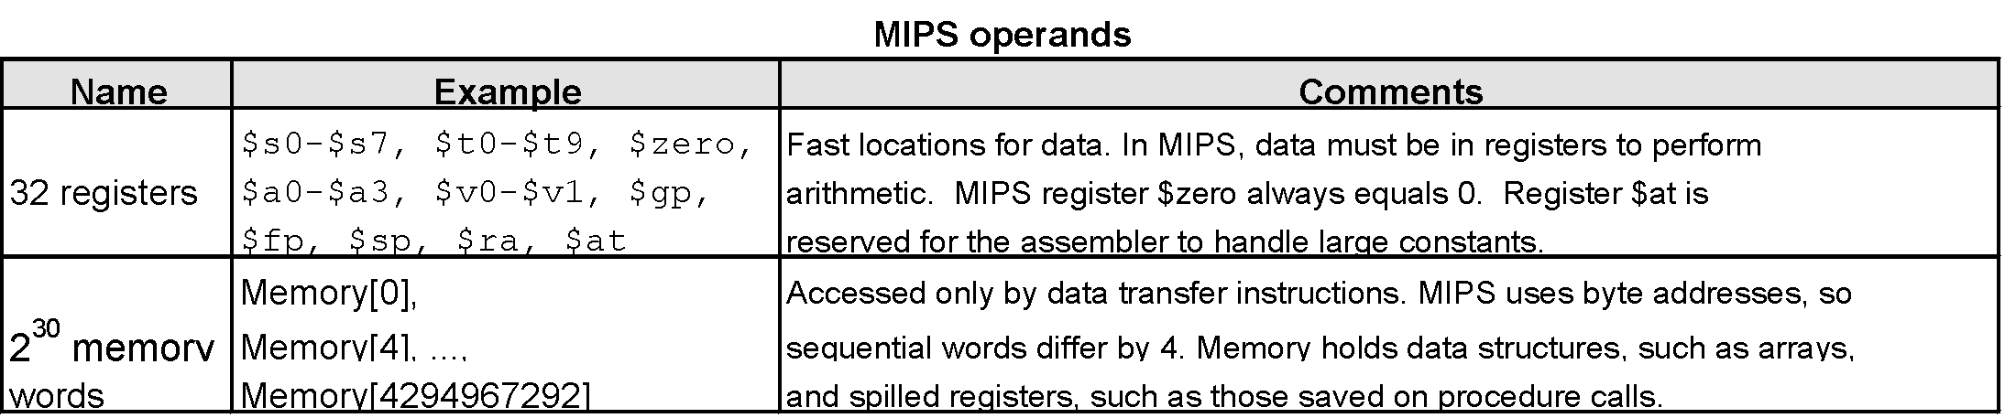
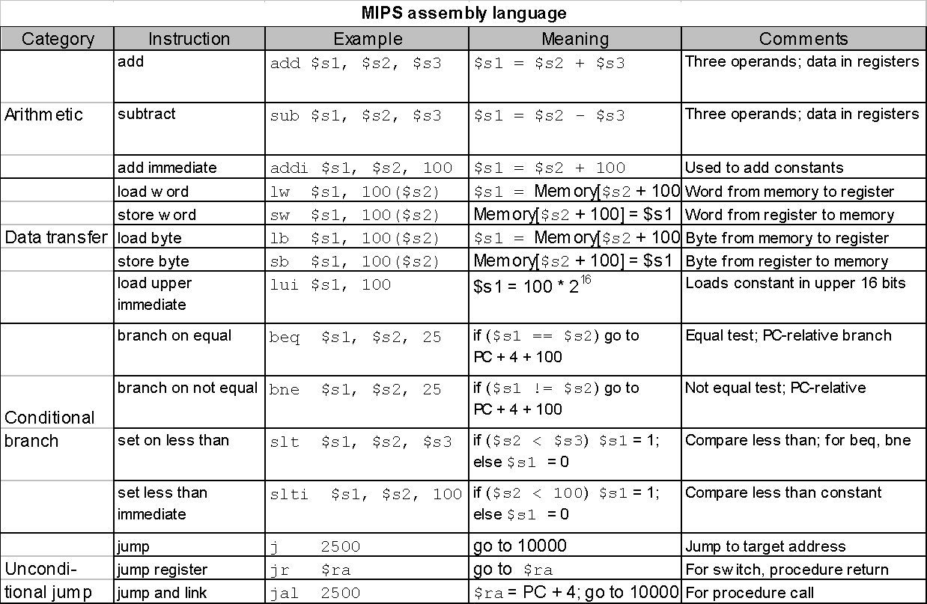
Summarize MIPS:
Notes:
Friday, November 16, 2007
Computer Architecture I - Class 11
‹#›

Slide 143
Summary: MIPS (RISC) Design Principles
Simplicity favors regularity
Fixed size instructions
Small number of instruction formats
Keep the register fields in the same place
Opcode always the first 6 bits

Slide 144
Summary: MIPS (RISC) Design Principles
Simplicity favors regularity
Fixed size instructions
Small number of instruction formats
Keep the register fields in the same place
Opcode always the first 6 bits
Smaller is faster
Limited instruction set
Limited number of registers in register file
Limited number of addressing modes

Slide 145
Summary: MIPS (RISC) Design Principles
Simplicity favors regularity
Fixed size instructions
Small number of instruction formats
Keep the register fields in the same place
Opcode always the first 6 bits
Smaller is faster
Limited instruction set
Limited number of registers in register file
Limited number of addressing modes
Good design demands good compromises
Compromise between providing for larger addresses and constants in instructions
Keep all instructions of the same length

Slide 146
Summary: MIPS (RISC) Design Principles
Simplicity favors regularity
Fixed size instructions
Small number of instruction formats
Keep the register fields in the same place
Opcode always the first 6 bits
Smaller is faster
Limited instruction set
Limited number of registers in register file
Limited number of addressing modes
Good design demands good compromises
Compromise between providing for larger addresses and constants in instructions
Keep all instructions of the same length
Make the common case fast
Arithmetic operands from the register file (load/store machine)
Allow instructions to contain immediate operands

Slide 147
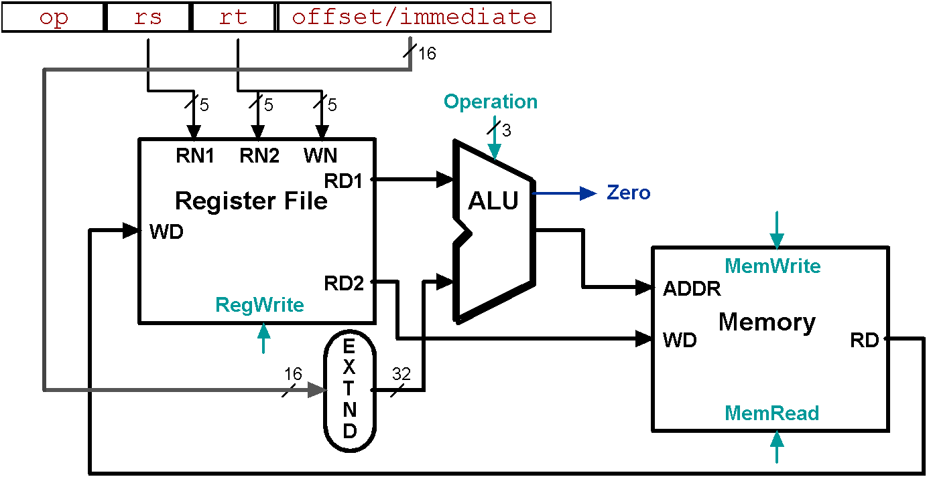
Animating the Datapath
lw rt, offset(rs)
R[rt] <- MEM[R[rs] + s_extend(offset)];
Notes:
Friday, November 16, 2007
Computer Architecture I - Class 11
‹#›
WN : Write (Destination) Register Number
RN : Register No.
RD : Read Data
WD : Write Data

Slide 148
Animating the Datapath
Back
sw rt, offset(rs)
MEM[R[rs] + sign_extend(offset)] <- R[rt]

Slide 149
End of Presentation

